Slide 1

Notes:
Welcome
Picture the following scenario:
You just joined a new project
Of course you put experience with Python and Jupyter Notebooks on your resume because of some Maths worksheet you did for a week
Now your PM expects you to handle some data analysis
What to do?
Well, fear not, for after this presentation, you’ll be able to deal with this without a problem

Slide 2


To the rescue!
Python
Pandas
Python is a high-level, general-purpose and easy to learn programming language which pandas is written in
Pandas is a fast, powerful, flexible and intuitive open source data analysis and manipulation tool
Notes:
To the rescue come..:
Python, which all of you have a bit of experience in, but in case you slept through the Maths classes;
It is a high-level, general-purpose and easy to learn programming language which Pandas is written in
Pandas itself is a Python library and known for being a fast, powerful, flexible and intuitive open source data analysis and manipulation tool
In case you’re curious, the name originates from the term “panel data”, HOWEVER it still lends itself to including gifs like [this into the presentation]

Slide 3

Notes:
…which, I mean it speaks for itself
I’ve spent an undisclosed amount of time looking for and converting these videos btw, but I’m getting sidetracked

Slide 4

Pandas (but more concrete)
Open source library that offers data structure support
Particularly aimed at tabular data
Direct competitor to R and other data science tools
Widely used in everything from simple data
manipulation to complex machine learning
Notes:
But what is pandas exactly and how does it work?
Open source library that offers data structure support and tools for data analysis
In particular, it’s great at handling TABULAR (=panel) data, in other words data arranged in rows and columns, essentially what we know from our databases classes
Provides a lot of functionality that until a few years ago was only available in statistical tools like R, matlab etc.
Also used to replaced Excel for smaller companies for generating insights in an easily reproducible manner
Widely used in everything from simple data manipulation to complex machine learning (hands down might be the most important tool in the field)

Slide 5
~50% of Python users
25% of all Developers
65% of Pandas users
Work with Pandas
Have used Pandas
Like it and want to continue using it
Notes:
It’s easy to understate the influence of pandas in the world of data science, so here’s some numbers:

Slide 6
Why is it so popular?
1.
2.
3.
4.
Built on top of Python
concise and practical design
Huge community
Built on top of NumPy and Cython
Cython: Transpile to C
Numpy: Improve Array-Optimization
Notes:
A big focus of Python is readability and usability - this of course translates to using Pandas
Pandas follows similar ideas, meaning you can really hit the ground running with minimal experience
It is built on top of Numpy and Cython, allowing for way more optimization than regular Python code
-> This results in Pandas being surprisingly performant IF and ONLY IF used correctly
As described before, the Pandas community is immense, so there is no shortage of guides, blogs, YouTube videos to learn from
-> Documentation can be a bit of a mixed bag, I personally learned to somewhat enjoy it but others think it sucks, make your own judgement

Slide 7

Any downsides?
1.
2.
3.
Requires proper use for big data
Steep learning curve
Poor documentation
“Easy to learn, hard to master”
(at times)
Notes:
I’ve been fanboying quite a bit, so are there any downsides too? -> YES!
If not used properly, it becomes borderline unusable with any significant amount of data
This goes back especially to the performance gained through NumPy-Arrays: Pandas will attempt to leverage it, but if it can’t it is SLOW
Using or not using these optimizations very quickly becomes the difference between your code running in minutes and literal miliseconds
Secondly, while picking pandas up is quite easy, the deeper functionality can be quite confusing, especially to beginners
Documentation is quite poor for getting into nooks and crannies, ties into the 2nd point: if you want to look up how to load data into pandas -> ezpz, if you really want to figure stuff out, good luck

Slide 8

Let’s get started!
Notes:
Let’s start slow..
(For me personally) sanity check whether pandas is imported as pd or not

Slide 9
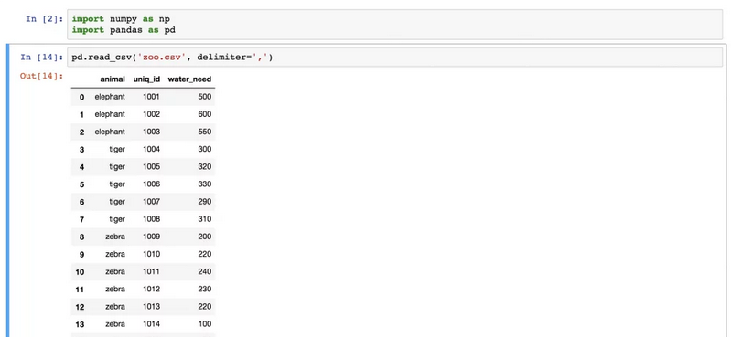
Let’s get started!
Notes:
This is what it looks like to read in a file that is already in the respective jupyter-notebook-directory using the “read_csv” method
All we need to do is tell pandas the name of the file (csv stands for comma separated values) and the delimiter (sometimes values are separated by semicolons or other symbols)
Other scenarios might include pulling data from a database or other data sources
No need to remember the syntax
Would just like to bring your attention to the result

Slide 10
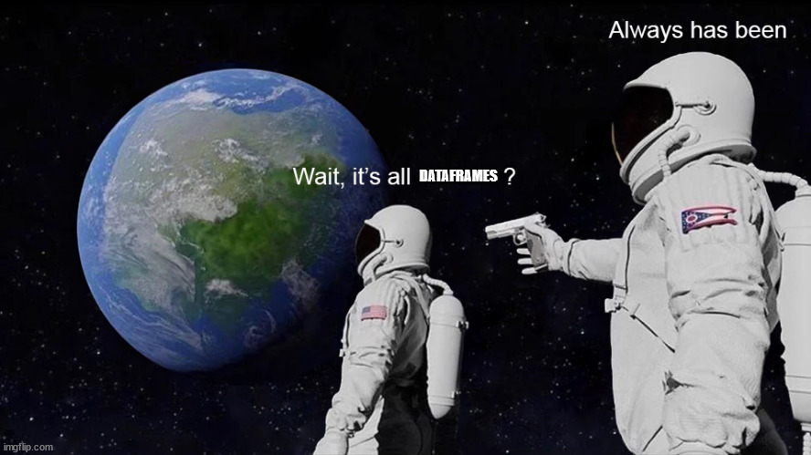
Dataframes
Single most important concept
Describe a 2D-”table”
Consists of rows and columns (labeled axes)
Notes:
For general use cases, dataframes are the single most important concept in Pandas
They describe a 2-Dimensional table
Pandas can handle more dimensions, but it’s really not amazing at it, also just not used very often
consisting of rows and columns (also labeled axes)

Slide 11
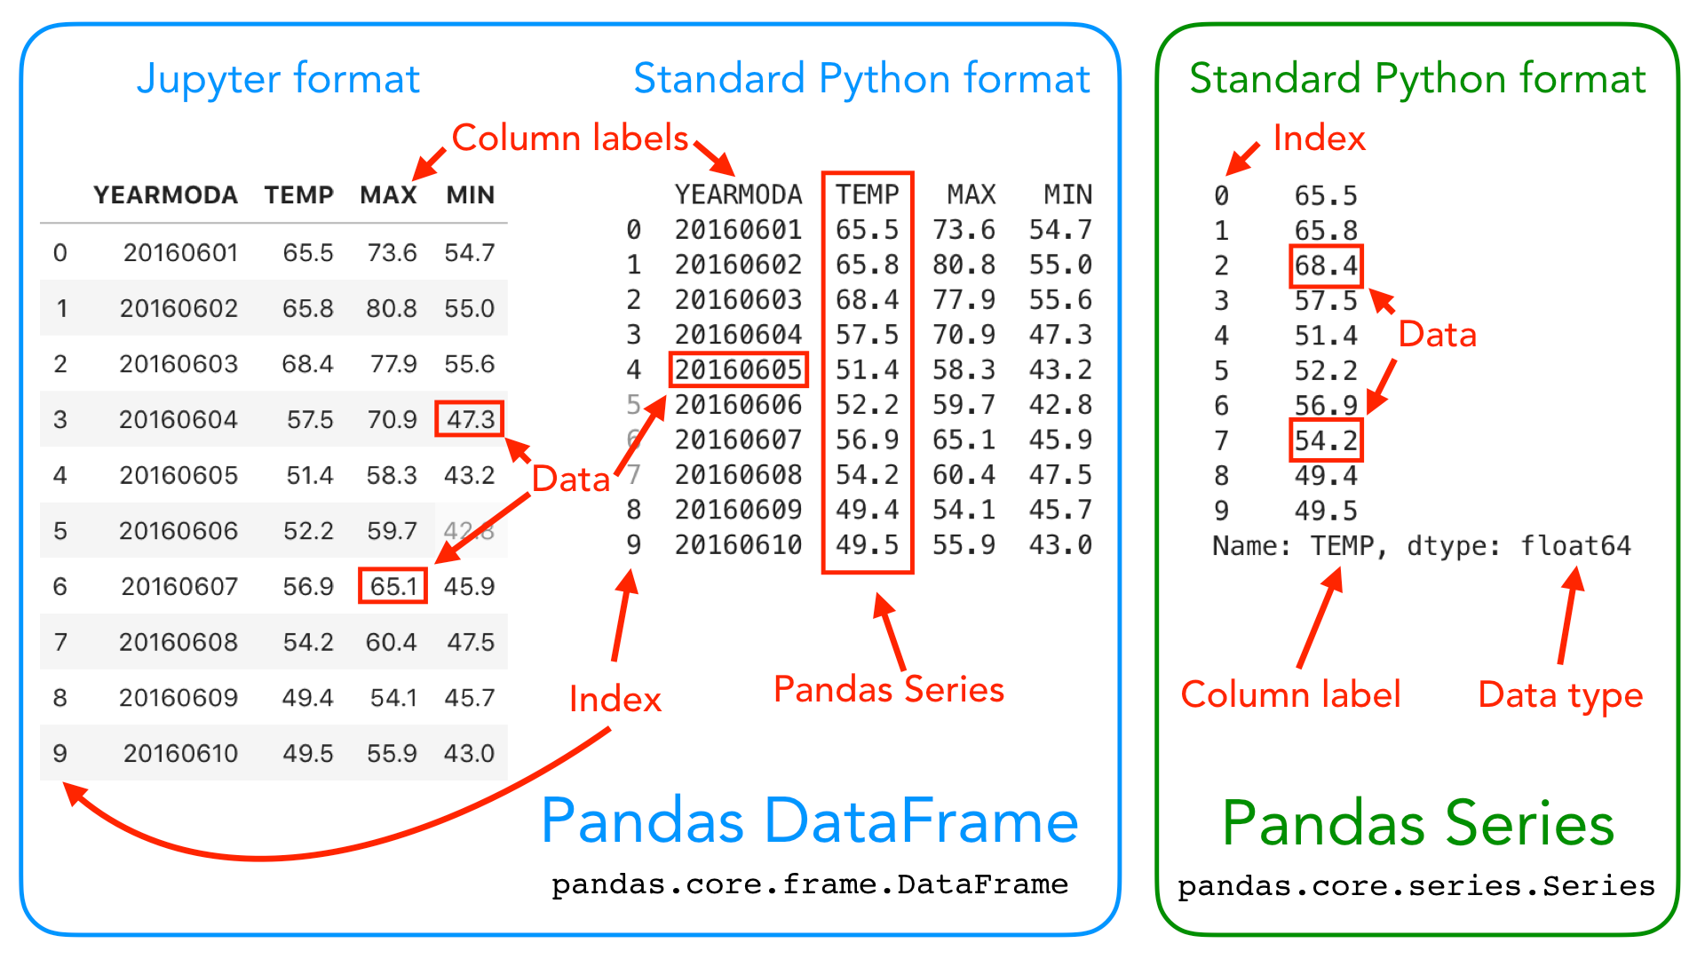
Let’s take another look
Notes:
This is mostly a recap by now
One additional terminology however:
Series! Whenever you hear that, I recommend you think of a column (bar the label, meaning the series is an array of values)

Slide 12
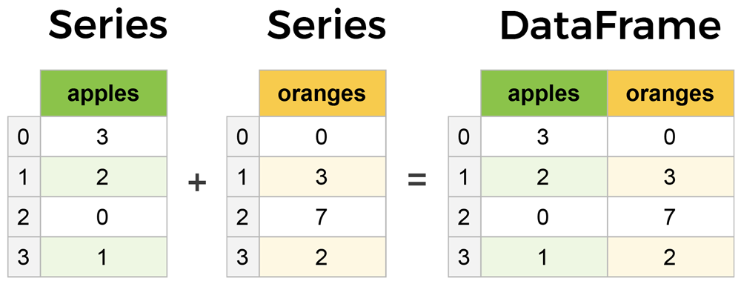
TEchnically..
Notes:
Technically speaking, a Series is the 1-Dimensional equivalent of a Dataframe
In the same manner, we could construct a 3-Dimensional data structure by combining DataFrames
-> Not important for today, plus it’s hard to visualize

Slide 13
Some examples to give you an idea
Notes:
Quite frankly, it’d be tedious (and also impossible) to go through all the functionality pandas provides
Also, this doesn’t reflect the way development with pandas would look like in reality
I tried to keep the exercises simple and intentionally
Still important to give you an idea of how it would look like

Slide 14
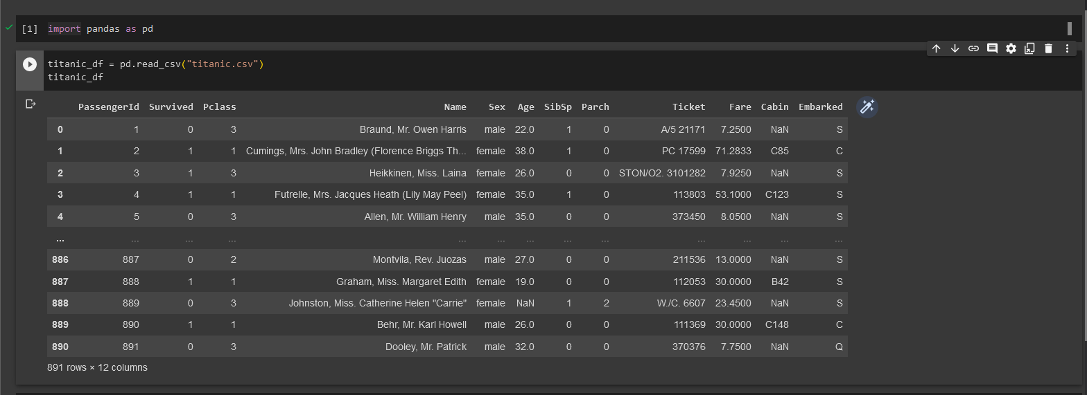
Some examples to give you an idea
Notes:
Again, our entrypoint into working with the tabular is our dataframe which we read in through some csv in the jupyter-directory
If we just call the df-object, it’ll print out its rows

Slide 15
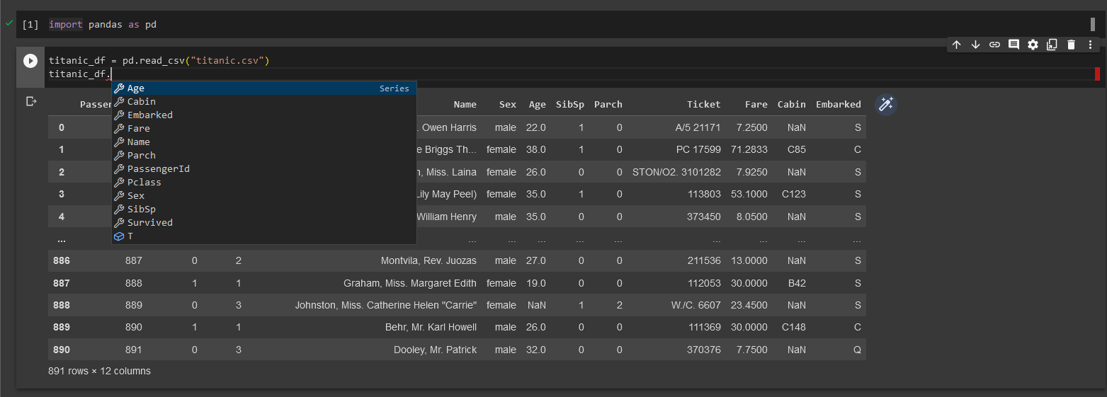
Some examples to give you an idea
Notes:
Note that you will have rudimentary autocomplete to see what your options are
this goes for dataframes as well as series!

Slide 16
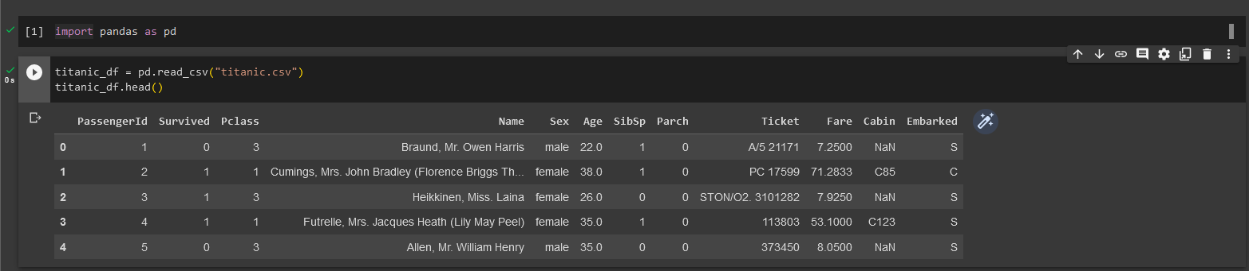
First steps!
Notes:
Usually the first step of analysing or manipulating data is just taking a look at it
Df provides “head()” and “tail()” method for this purpose

Slide 17
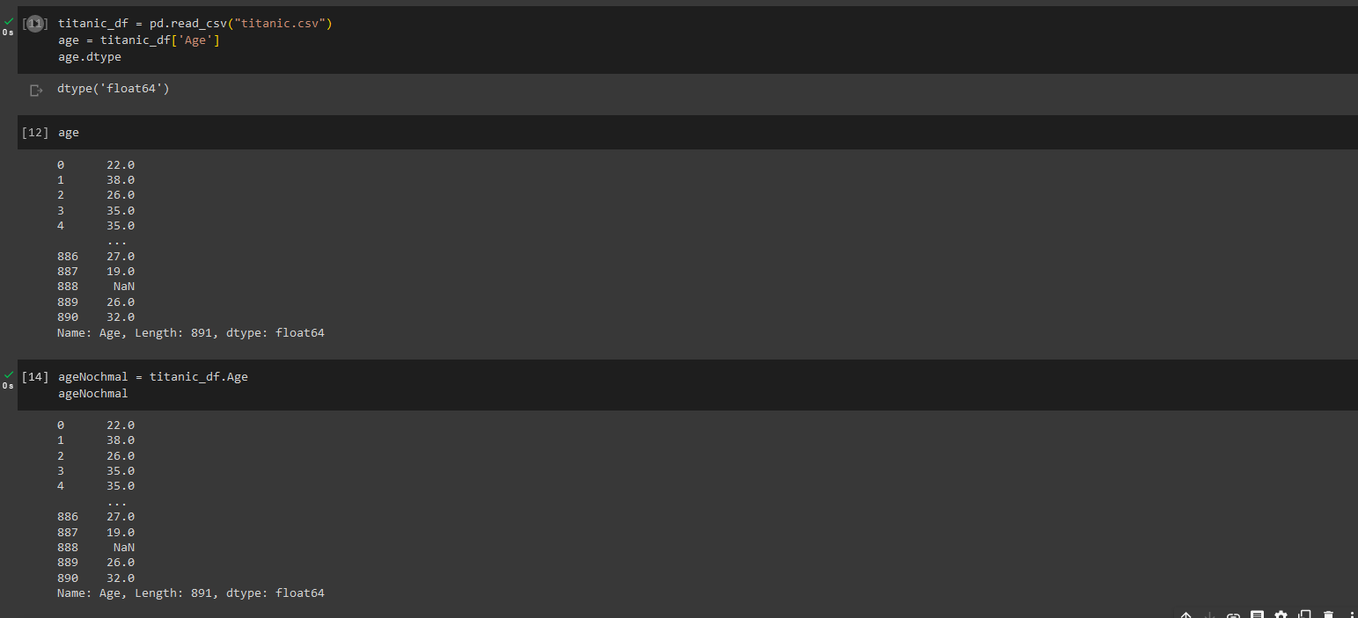
Accessing parts of the data
Notes:
Oftentimes several methods to achieve a goal
We can use a square-bracket notation and write the Column Name in quotes
Or access it via the dot notation

Slide 18
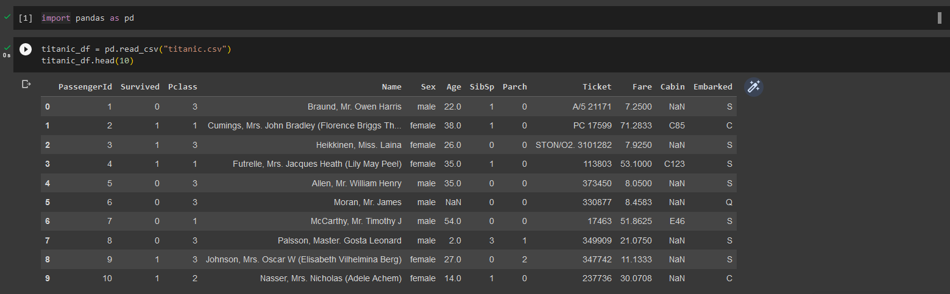
Let’s gain some insights!
Notes:
Here’s the first 10 lines of the whole DF again
Let’s say we want to see how much money we made by running the titanic (if it hadn’t crashed :^))

Slide 19
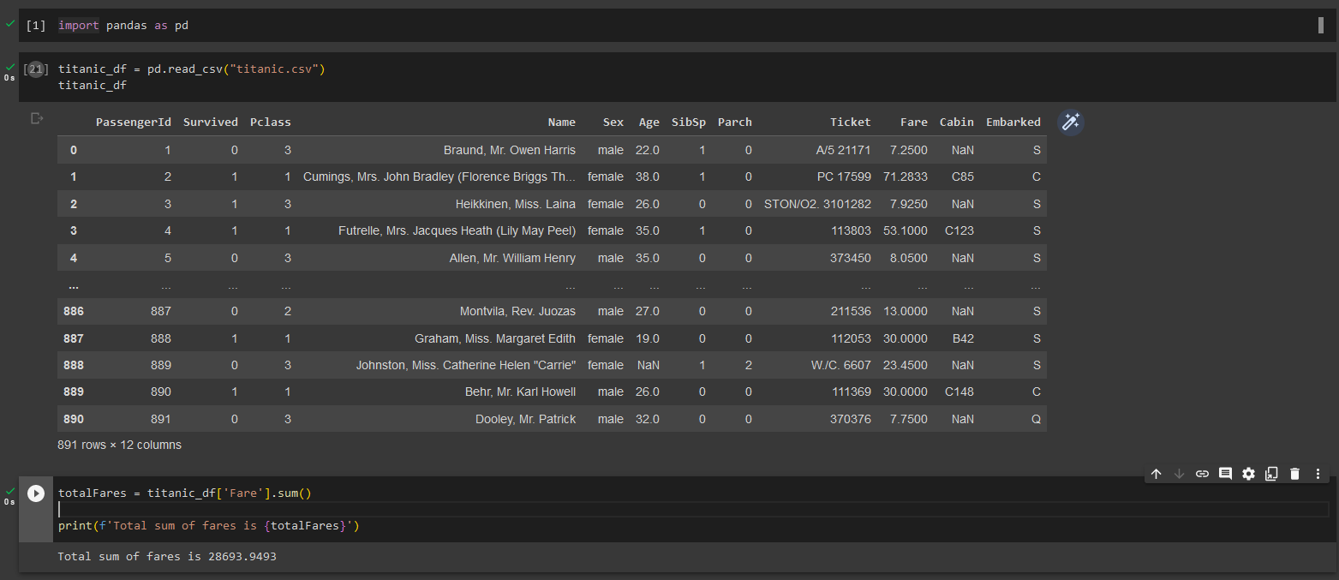
Let’s gain some insights!
Notes:
Here’s the first 10 lines of the whole DF again
Let’s say we want to see how much money we made by running the titanic (if it hadn’t crashed :^))

Slide 20
Finally getting our hands dirty
Have fun!
Notes:
Marks the end of the theoretical part of my presentation
If you have any questions (right now or during your exercises): DMs are open
Remember if you manage to break your df somehow, just rerun the cells from the top down!

